Slide 1

Welcome

Slide 2
Introduction to Programming

Slide 3
Objectives

Slide 4
Objective
Given as task, create pseudocode
Given pseudocode, create a flowchart
Define/ describe these terms: program, compile vs interpret, loop, function, syntax, code and many more

Slide 5
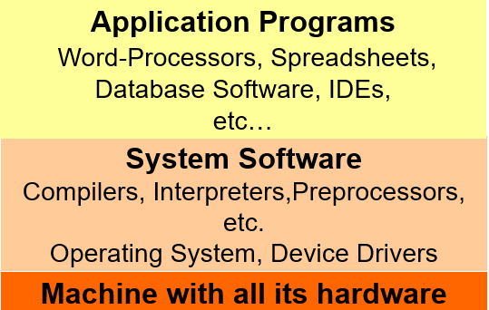
Layered View of the Computer

Slide 6

What is Programming?
Series of instructions to a computer to accomplish a task
Instructions must be written in a way the computer can understand
Programming languages are used to write programs

Slide 7
What is Programming?
Once the code(language) of a program has been written, it must be executed (run, started)
You may need to type the name of program to start it
Some programming languages (Java, C++) require code to be compiled(translated to binary) before it can be started.
Other(JavaScript) are interpreted.

Slide 8

What is a programming language ?
Set of commands that a computer has been taught to understand
Languages that look like machine code are used to control a computer's central processing unit (CPU).
Other languages that look like English(high level)

Slide 9
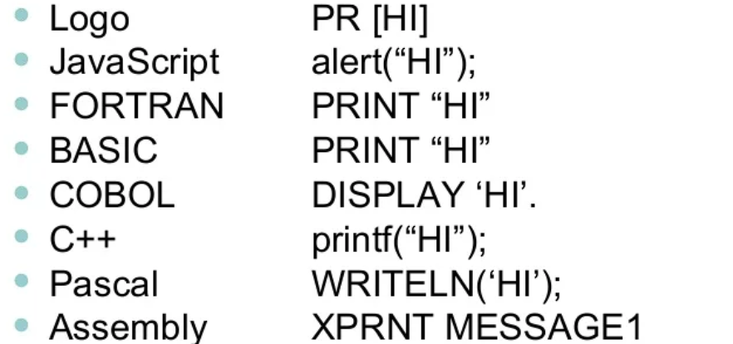
What does programming look like ?
Here are some of the examples of an instructions to print word HI

Slide 10
Computer Languages
Machine Language
Uses binary code
Machine-dependent
Not portable
Assembly Language
Uses mnemonics
Machine-dependent
Not usually portable
High-Level Language (HLL)
Uses English-like language
Machine independent
Portable (but must be compiled for different platforms)
Examples: Pascal, C, C++, Java, Fortran, . . .

Slide 11
Machine Language
Operation | Address
0010 | 0000 0000 0100
0100 | 0000 0000 0101
0011 | 0000 0000 0110
The representation of a computer program which is actually read and understood by the computer.
A program in machine code consists of a sequence of machine instructions.
Instructions:
Machine instructions are in binary code
Instructions specify operations and memory cells involved in the operation

Slide 12
Assembly Language
A symbolic representation of the machine language of a specific processor.
Is converted to machine code by an assembler.
Usually, each line of assembly code produces one machine instruction (One-to-one correspondence).
Programming in assembly language is slow and error-prone but is more efficient in terms of hardware performance.
Mnemonic representation of the instructions and data
Example:
Load Price
Add Tax
Store Cost

Slide 13
High-level language
A programming language which use statements consisting of English-like keywords such as
"FOR", "PRINT" or “IF“, ... etc.
Each statement corresponds to several machine language instructions (one-to-many correspondence).
Much easier to program than in assembly language.
Data are referenced using descriptive names
Operations can be described using familiar symbols
Example:
Cost := Price + Tax

Slide 14
Syntax & Semantics
Syntax:
–The structure of strings in some language. A language's syntax is described by a grammar.
–Examples:
•Binary number
<binary_number> = <bit> | <bit> <binary_number>
<bit> = 0 | 1
•Identifier
<identifier> = <letter> {<letter> | <digit> }
<letter> = a | b | . . . | z
<digit = 0 | 1 | . . . | 9
Semantics:
–The meaning of the language

Slide 15
Syntax & Grammars
Syntax descriptions for a PL are themselves written in a formal language.
E.g. Backus-Naur Form (BNF)
The formal language is not a PL but it can be implemented by a compiler to enforce grammar restrictions.
Some PLs look more like grammar descriptions than like instructions.

Slide 16
Compilers & Programs
Compiler
A program that converts another program from some source language (or high-level programming language / HLL) to machine language (object code).
Some compilers output assembly language which is then converted to machine language by a separate assembler.
Is distinguished from an assembler by the fact that each input statement, in general, correspond to more than one machine instruction.

Slide 17
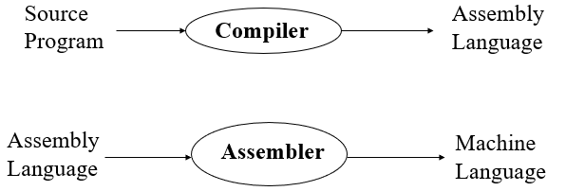
Compilation into Assembly Language

Slide 18
Compilers & Programs
Source program
The form in which a computer program, written in some formal programming language, is written by the programmer.
Can be compiled automatically into object code or machine code or executed by an interpreter.
Pascal source programs have extension ‘.pas’

Slide 19
Compilers & Programs
Object program
Output from the compiler
Equivalent machine language translation of the source program
Files usually have extension ‘.obj’
Executable program
Output from linker/loader
Machine language program linked with necessary libraries & other files
Files usually have extension ‘.exe’

Slide 20
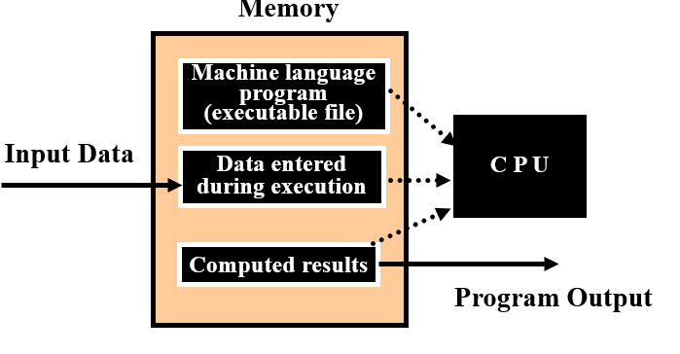
Running Programs
•Steps that the computer goes through to run a program:

Slide 21
Program Execution
Steps taken by the CPU to run a program (instructions are in machine language):
Fetch an instruction
Decode (interpret) the instruction
Retrieve data, if needed
Execute (perform) actual processing
Store the results, if needed

Slide 22
Program Errors
•Syntax Errors:
Errors in grammar of the language
•Runtime error:
When there are no syntax errors, but the program can’t complete execution
Divide by zero
Invalid input data
•Logical errors:
The program completes execution, but delivers incorrect results
Incorrect usage of parentheses

Slide 23
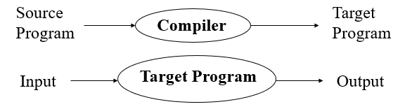
Compilation
Compiler translates source into target (a machine language program)
Compiler goes away at execution time
Compiler is itself a machine language program, presumably created by compiling some other high-level program
Machine language, when written in a format understood by the OS is object code

Slide 24
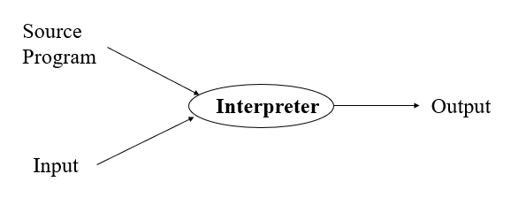
Interpretation
The interpreter stays around during execution
It reads and executes statements one at a time

Slide 25
Compilation vs Interpretation
• Compilation:
Syntax errors caught before running the program
Better performance
Decisions made once, at compile time
Interpretation:
Better diagnostics (error messages)
More flexibility
Supports late binding (delaying decisions about program implementation until runtime)
Can better cope with PLs where type and size of variables depend on input
Supports creation/modification of program code on the fly (e.g. Lisp, Prolog)

Slide 26
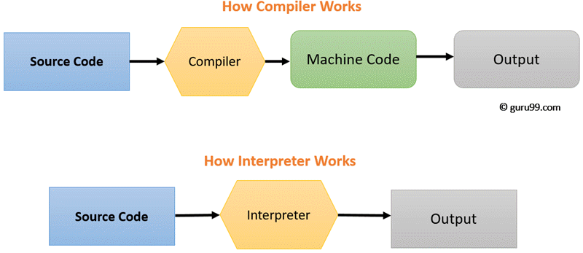
Compilation vs. Interpretation

Slide 27
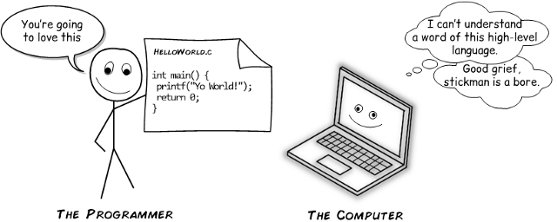
Compilation vs. Interpretation
(what it really says ?)

Slide 28
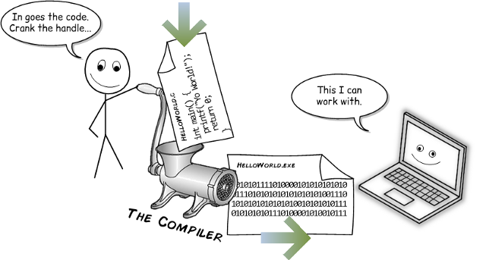
Compilation vs. Interpretation
(what it really says ?)

Slide 29
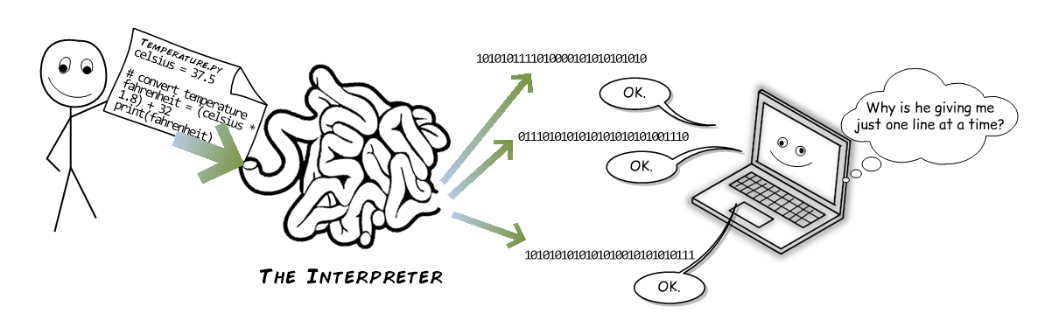
Compilation vs Interpretation (what it really says ?)

Slide 30
Just-in-time compilation
The basic idea was this: Since compilers have godly powers of optimization, and seeing as compiled code is so much faster than interpreted code, why not just compile everything?
The trick is to compile is just before you run it. That way there’s no problem with compatibility, because your code is compiled on the same computer that’s going to run it.

Slide 31
Just-in-time compilation
JIT really took off with Java. Later on, it was used for the .NET family of languages (like C# and VB.NET). On both these platforms, there are actually two compilation steps:
The first step turns your high-level code into medium-level code that’s somewhat optimized and much more compact. (In .NET, that medium-level code is called IL, for Intermediate Language.)
The second step is the JIT that turns your medium-level code into traditional low-level code. It takes place when you run the program.

Slide 32
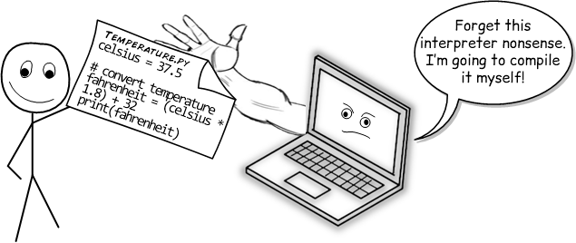

Slide 33
Just-in-time compilation
Often, these two compilation steps happen on different computers.
For example, if it’s a desktop program, the high-to-medium step happens on your computer and the medium-to-low step happens on the user’s computer.
If it’s a server-side web application, the high-to-medium step happens on your computer and the medium-to-low step happens on the web server.

Slide 34
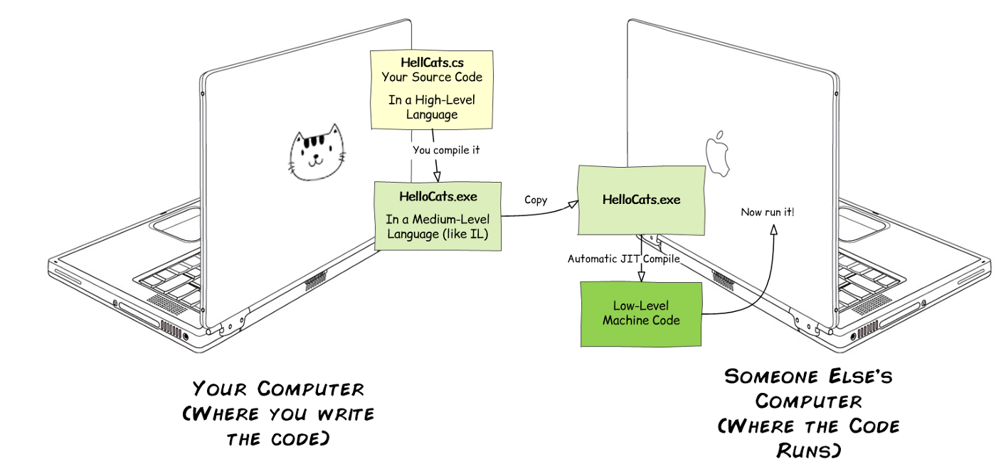

Slide 35

How do you write a program?
Decide what steps are needed to complete the task
Write the steps in pseudocode or as a flowchart
Tsanslate into the programming language
Try out the program and
debug it --> Fix it

Slide 36
Pseudocode
List of steps written in English
Like the instructions for a recipe
Must be in the right sequence
(Imagine making coffee/tea/etc.)

Slide 37
Sample Pseudocode
Task: add two numbers
Pseudocode:
Start
Get two numbers
Add them
Print the answer
End

Slide 38
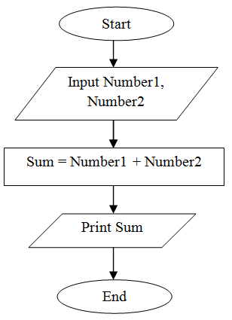
How does a flowchart look like?
Pseudocode from the previous slide would like this as a flowchart

Slide 39
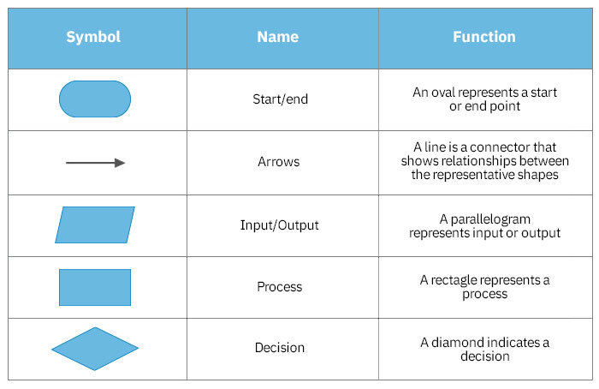
What are those funny symbols?

Slide 40
Elements Of A Program
All languages have certain features in common. For example:
Variables
Commands/Syntax
Loops
Decision
Functions
Each programming language has a different set of rules about these features

Slide 41
Before C++, there was C
C language was developed in 1972 by Dennis Ritchie at Bell Telephone laboratories, primarily as a systems programming language (a language to write operating systems with).
Ritchie’s primary goals were to produce a minimalistic language that was easy to compile, allowed efficient access to memory, produced efficient code, and was self-contained (not reliant on other programs).

Slide 42
Before C++, there was C
C ended up being so efficient and flexible that in 1973, Ritchie and Ken Thompson rewrote most of the Unix operating system using C.
Many previous operating systems had been written in assembly. Unlike assembly, which produces programs that can only run on specific CPUs, C has excellent portability, allowing Unix to be easily recompiled on many different types of computers and speeding its adoption. C and Unix had their fortunes tied together, and C’s popularity was in part tied to the success of Unix as an operating system.

Slide 43
Before C++, there was C
In 1978, Brian Kernighan and Dennis Ritchie published a book called “The C Programming Language”.
This book, which was commonly known as K&R (after the authors’ last names), provided an informal specification for the language and became a de facto standard. When maximum portability was needed, programmers would stick to the recommendations in K&R, because most compilers at the time were implemented to K&R standards.

Slide 44
Let's get Started with C

Slide 45
Our first program
C is a compiled language - which means that in order to run it, the compiler must take the code that we wrote, process it, and then create an executable file.
The most basic function called printf, which prints to the screen, is defined in the stdio.h header file.

Slide 46
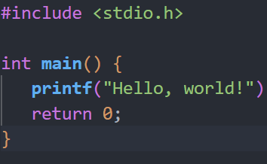
Hello World !!

Slide 47
Congratulations on your first C program

Slide 48
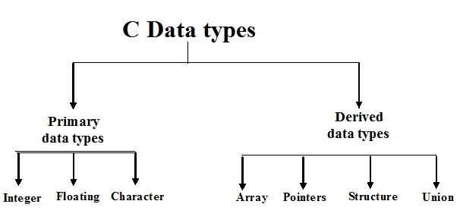
Variables and Types

Slide 49
Variable Names
All C variables must be identified with unique names.
These unique names are called identifiers.
Identifiers can be short names (like x and y) or more descriptive names (age, sum, total Volume).

Slide 50
General rules for naming variables
Names can contain letters, digits and underscores
Names must begin with a letter or an underscore (_)
Names are case sensitive (myVar and myvar are different variables)
Names cannot contain whitespaces or special characters like !, #, %, etc.
Reserved words (such as int) cannot be used as names

Slide 51
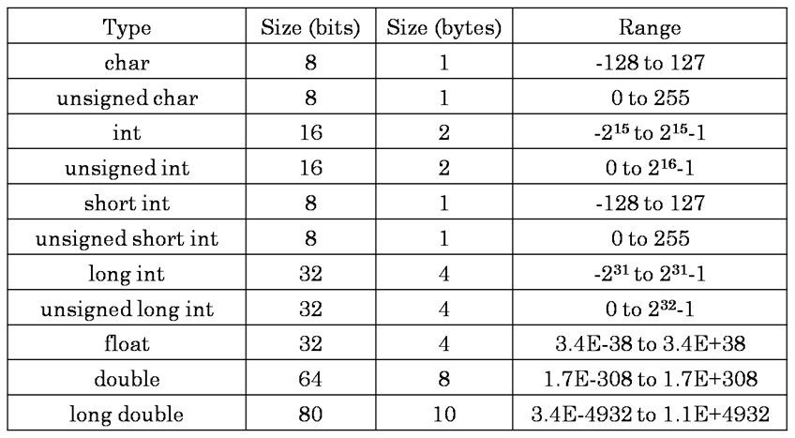
Data Types

Slide 52
Constants
When you don't want others (or yourself) to override existing variable values, use the const keyword (this will declare the variable as "constant", which means unchangeable and read-only).
When you declare a constant variable, it must be assigned with a value.

Slide 53
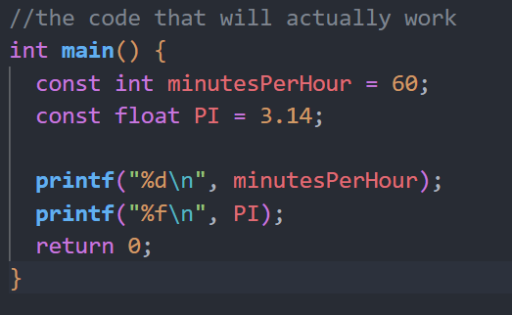
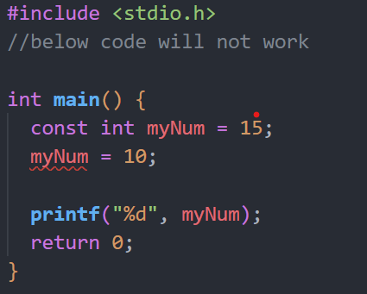
Constants

Slide 54
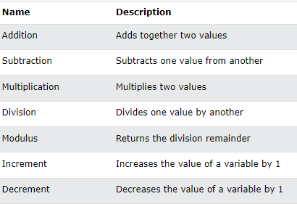
Operators (Arithmetic Operators)

Slide 55
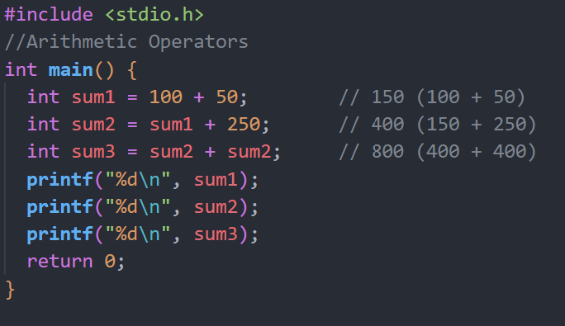
Operators (Arithmetic Operators)

Slide 56
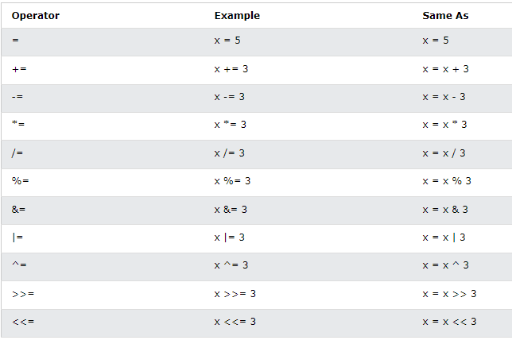
Assignment Operators

Slide 57
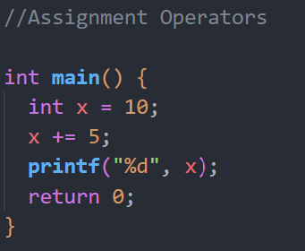
Assignment Operators

Slide 58
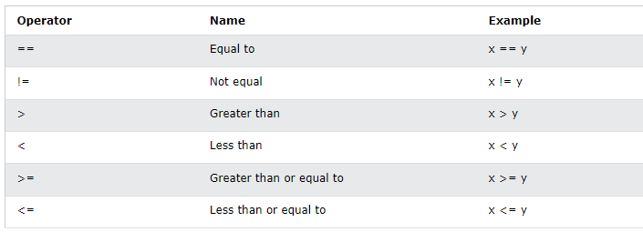
Comparison Operators

Slide 59
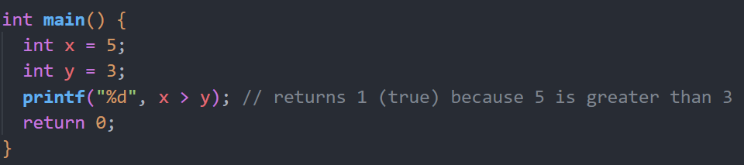
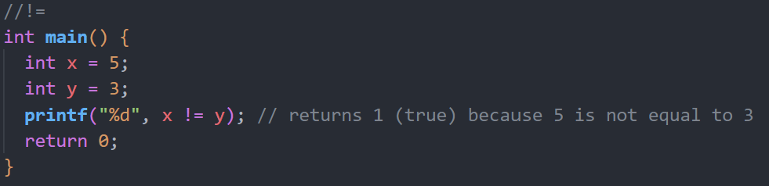
Comparison Operators

Slide 60
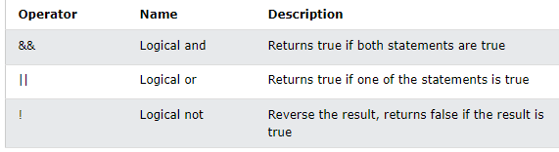
Logical Operators

Slide 61
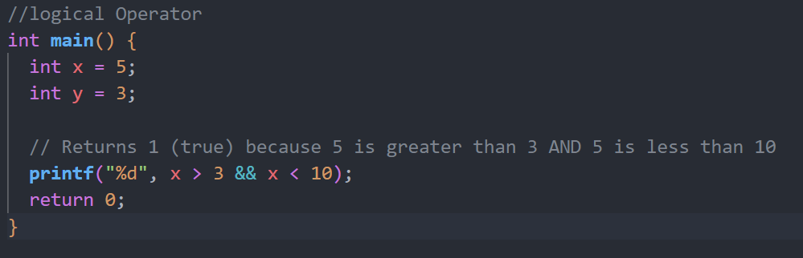
Logical Operators

Slide 62
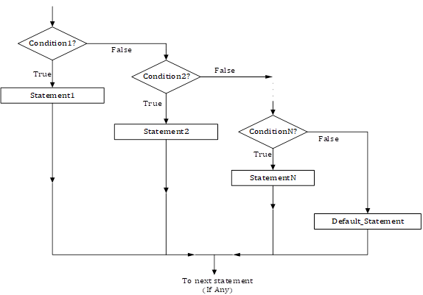
Control Statements
if statement is used to test the condition. There are various types of if statements in C/C++.
if statement
if-else statement
nested if statement
if-else-if ladder

Slide 63
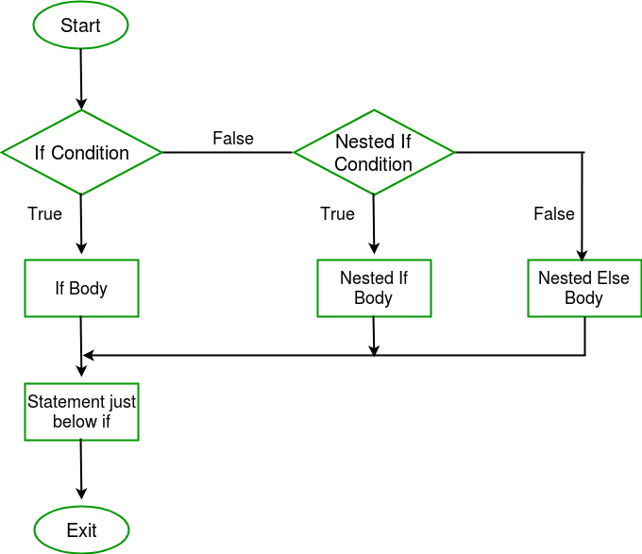
If-else Loop
if-else statement also tests the condition.
It executes if block if condition is true otherwise else block is executed.

Slide 64
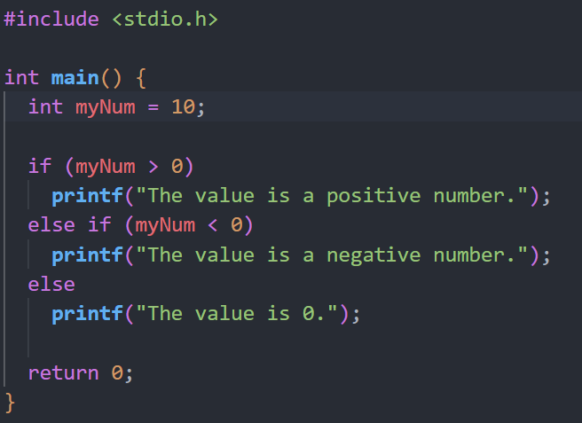
If-else Loop

Slide 65
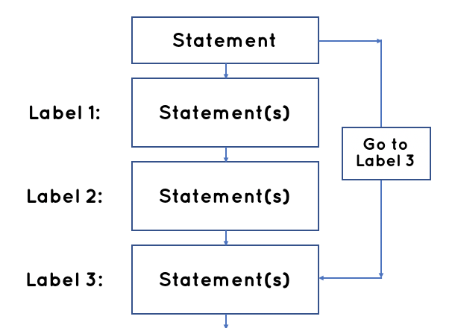
Goto Statement
Also known as jump statement. It is used to transfer control to the other part of the program. It unconditionally jumps to the specified label.
It can be used to transfer control from deeply nested loop or switch case label.

Slide 66
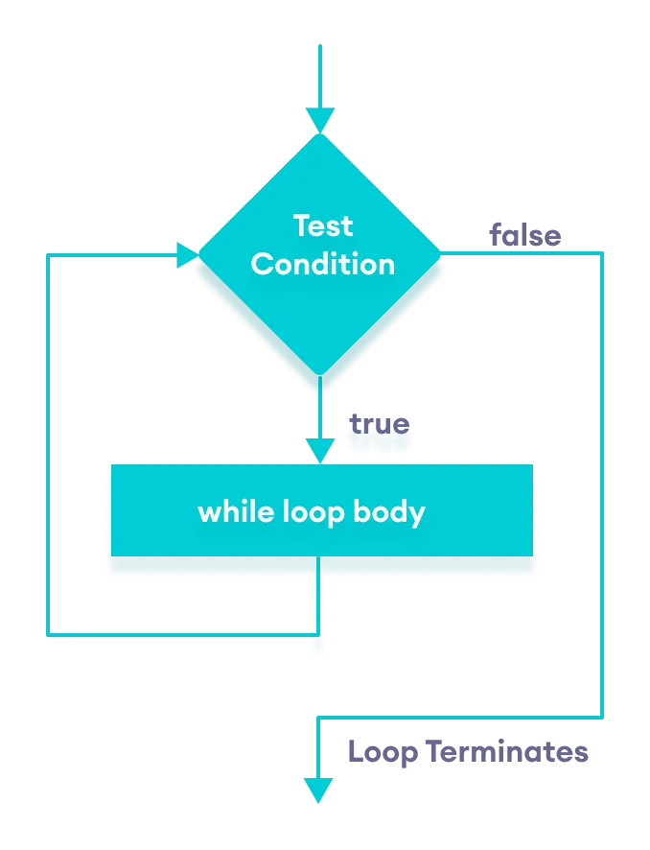
While Loop
used to iterate a part of the program several times. If the number of iteration is not fixed.
it is recommended to use while loop than for loop.

Slide 67
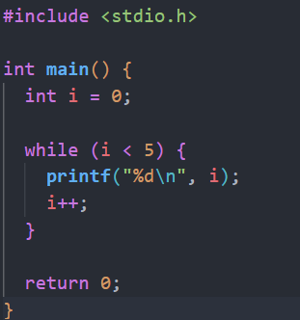
While Loop

Slide 68
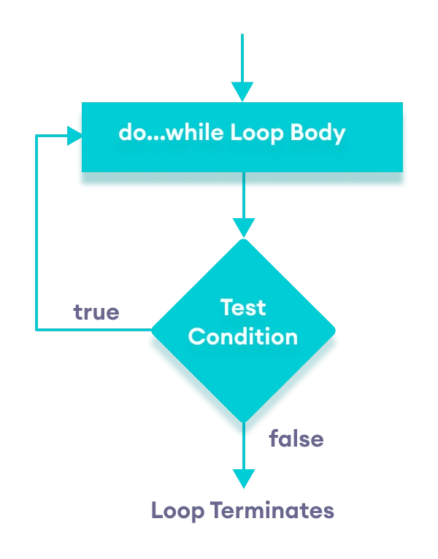
Do-While Loop
Used to iterate a part of the program several times.
If the number of iteration is not fixed and you must have to execute the loop at least once

Slide 69
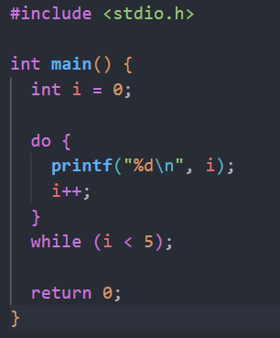
Do-While Loop

Slide 70
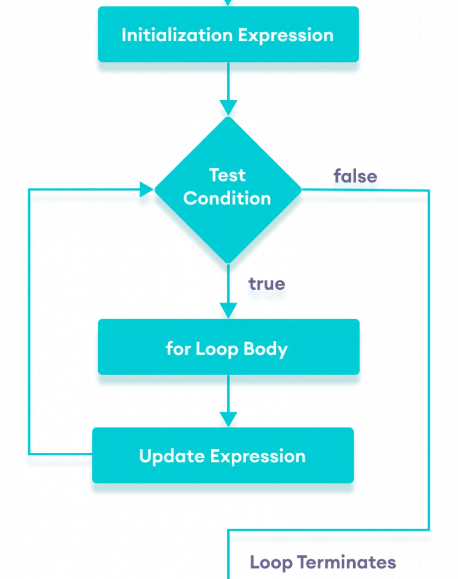
For loop
used to iterate a part of the program several times. If the number of iteration is fixed, it is recommended to use for loop than while or do-while loops.

Slide 71
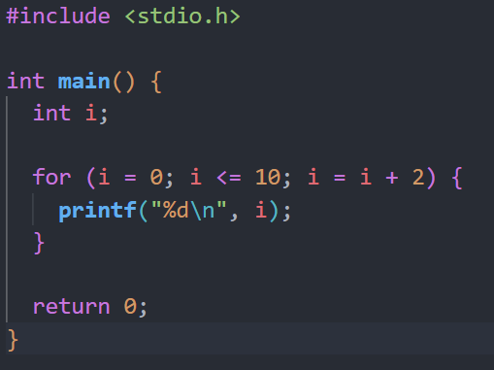
For loop

Slide 72
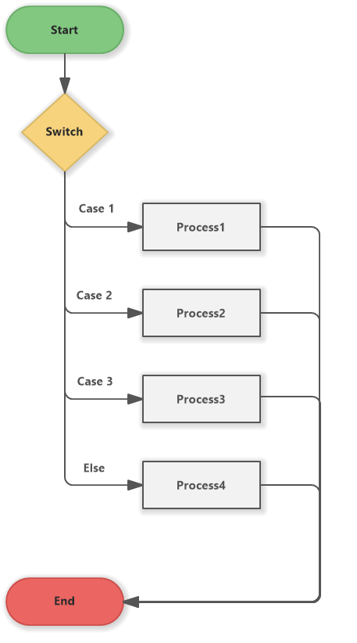
Switch case
Used for executing one condition from multiple conditions.
It is similar to an if-else-if ladder. Switch statement consists of conditional based cases and a default case. In a switch statement, the “case value” can be of “char” and “int” type

Slide 73
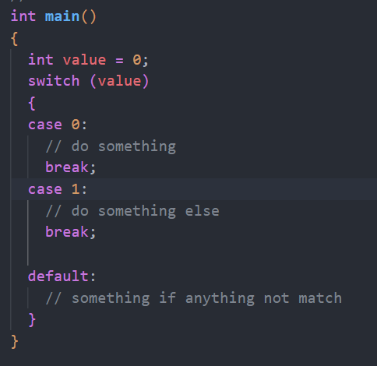
Switch case

Slide 74
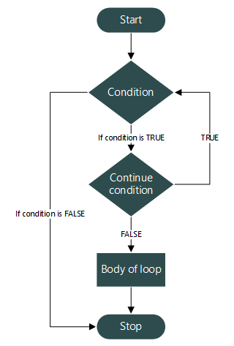
Continue Statement
Used to continue loop.
It continues the current flow of the program and skips the remaining code at specified condition. In case of inner loop, it continues only inner loop.

Slide 75
The default Keyword
The default keyword specifies some code to run if there is no case match

Slide 76
The break Keyword
When C reaches a break keyword, it breaks out of the switch block.
This will stop the execution of more code and case testing inside the block.
When a match is found, and the job is done, it's time for a break. There is no need for more testing.

Slide 77
End Of Day1

Slide 78
Sizeof Operator
The memory size (in bytes) of a data type or a variable can be found with the sizeof operator:

Slide 79
Ternary Operator
There is also a short-hand if else, which is known as the ternary operator because it consists of three operands.
It can be used to replace multiple lines of code with a single line. It is often used to replace simple if else statements

Slide 80
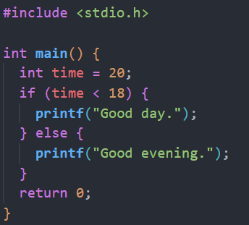
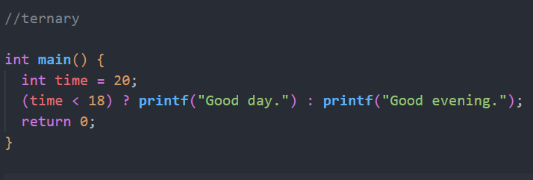
Ternary Operator

Slide 81
Functions
A function is a block of code which only runs when it is called.
You can pass data, known as parameters, into a function.
Functions are used to perform certain actions, and they are important for reusing code: Define the code once, and use it many times.

Slide 82
Predefined Functions
So it turns out you already know what a function is.
You have been using it the whole time while studying this tutorial!
For example, main() is a function, which is used to execute code, and printf() is a function; used to output/print text to the screen

Slide 83

Function Parameters
Information can be passed to functions as a parameter. Parameters act as variables inside the function.
Parameters are specified after the function name, inside the parentheses. You can add as many parameters as you want, just separate them with a comma

Slide 84
Return Values
The void keyword, indicates that the function should not return a value.
If you want the function to return a value, you can use a data type (such as int or float, etc.) instead of void, and use the return keyword inside the function

Slide 85
Function Declaration and Definition
We just learned from the previous slides that you can create and call a function.
A function consist of two parts:
Declaration: the function's name, return type, and parameters (if any)
Definition: the body of the function (code to be executed)
You will often see C programs that have function declaration above main(), and function definition below main(). This will make the code better organized and easier to read

Slide 86
Recursion
Recursion is the technique of making a function call itself.
This technique provides a way to break complicated problems down into simple problems which are easier to solve.

Slide 87

Structures (structs)
Structures (also called structs) are a way to group several related variables into one place. Each variable in the structure is known as a member of the structure.
A structure can contain many different data types
(int, float, char, etc.)

Slide 88
Structure
To access members of a structure, use the dot syntax (.)
We can create multiple structure variables with different values, using just one structure

Slide 89
End of c, Beginning of C++

Slide 90
C++ (pronounced see plus plus)
Developed by Bjarne Stroustrup at Bell Labs as an extension to C, starting in 1979. C++ adds many new features to the C language, and is perhaps best thought of as a superset of C, though this is not strictly true (as C99 introduced a few features that do not exist in C++).
C++’s claim to fame results primarily from the fact that it is an object-oriented language.
As for what an “object” is and how it differs from traditional programming methods, well.

Slide 91
C++ (pronounced see plus plus)
Four major updates to the C++ language (C++11, C++14, C++17, and C++20) have been made since then, each adding additional functionality. C++11 in particular added a huge number of new capabilities, and is widely considered to be the new baseline version of the language. Future upgrades to the language are expected every three or so years, with the feature set for C++23 already starting to be formulated.
Each new formal release of the language is called a language standard (or language specification). Standards are named after the year they are released in. For example, there is no C++15, because there was no new standard in 2015.

Slide 92
Q: What is C++ good at?
C++ excels in situations where high performance and precise control over memory and other resources is needed. Here are a few common types of applications that most likely would be written in C++:
Video games
Real-time systems (e.g. for transportation, manufacturing, etc…)
High-performance financial applications (e.g. high frequency trading)
Graphical applications and simulations
Productivity / office applications
Embedded software
Audio and video processing
Artificial intelligence and neural networks

Slide 93
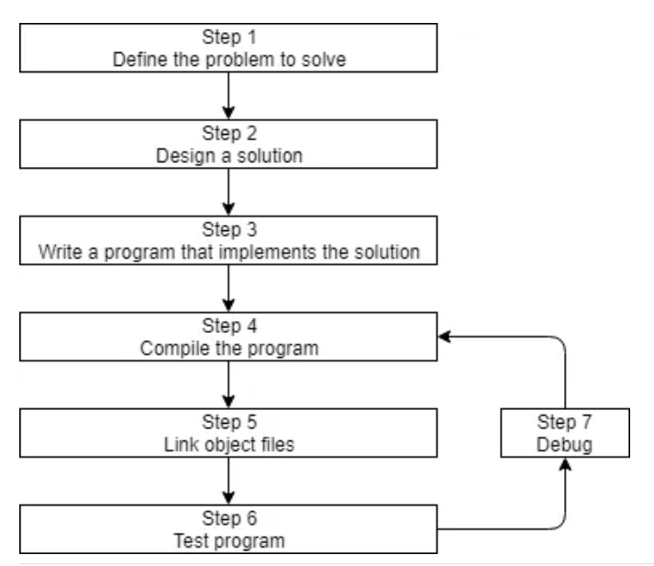
Introduction to C++ development
Before we can write and execute our first C++ program, we need to understand in more detail how C++ programs get developed. Here is a graphic outlining a simplistic approach:

Slide 94
Step 1: Define the problem that you would like to solve
This is the “what” step, where you figure out what problem you are intending to solve.
Here are a few examples:
“I want to write a program that will allow me to enter many numbers, then calculates the average.”
“I want to write a program that generates a 2d maze and lets the user navigate through it. The user wins if they reach the end.”

Slide 95
Step 2: Determine how you are going to solve the problem
This is the “how” step, where you determine how you are going to solve the problem you came up with in step 1. It is also the step that is most neglected in software development. The crux of the issue is that there are many ways to solve a problem.
Typically, good solutions have the following characteristics:
They are straightforward (not overly complicated or confusing).
They are well documented (especially around any assumptions being made or limitations).
They are built modularly, so parts can be reused or changed later without impacting other parts of the program.
They are robust, and can recover or give useful error messages when something unexpected happens

Slide 96

Bugs
The term bug was first used by Thomas Edison back in the 1870s! However, the term was popularized in the 1940s when engineers found an actual moth stuck in the hardware of an early computer, causing a short circuit.
Both the log book in which the error was reported and the moth are now part of the Smithsonian Museum of American History

Slide 97
Well, It's TRUE
Studies have shown that only 20% of a programmer’s time is actually spent writing the initial program.
The other 80% is spent on maintenance, which can consist of debugging (removing bugs), updates to cope with changes in the environment , enhancements, or internal improvements (to increase reliability or maintainability).
Consequently, it’s worth your time to spend a little extra time up front thinking about the best way to tackle a problem, what assumptions you are making, and how you might plan for the future, in order to save yourself a lot of time and trouble down the road.

Slide 98
Step 3: Write the program
In order to write the program, we need two things:
First, we need knowledge of a programming language.
Second, we need a text editor to write and save our written programs
The programs you write will typically be named something.cpp, where something is replaced with the name of your choosing for the program (e.g. calculator, hi-lo, etc…).
The .cpp extension tells the compiler (and you) that this is a C++ source code file that contains C++ instructions. Note that some people use the extension .cc instead of .cpp, but we recommend you use .cpp.

Slide 99
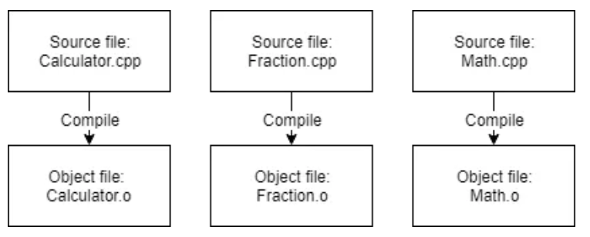
Step 4: Compiling your source code
In order to compile a C++ program, we use a C++ compiler. The C++ compiler sequentially goes through each source code (.cpp) file in your program and does two important tasks:
First, it checks your code to make sure it follows the rules of the C++ language. If it does not, the compiler will give you an error (and the corresponding line number) to help pinpoint what needs fixing. The compilation process will also be aborted until the error is fixed.
Second, it translates your C++ source code into a machine language file called an object file. Object files are typically named name.o or name.obj, where name is the same name as the .cpp file it was produced from.

Slide 100
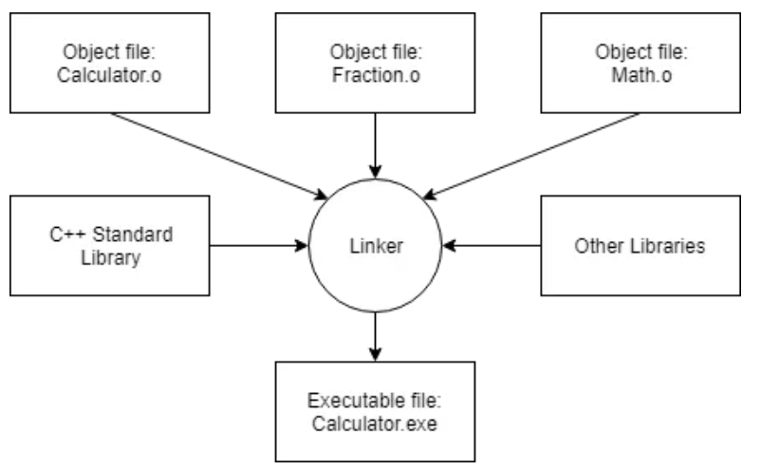
Step 5: Linking object files and libraries
After the compiler creates one or more object files, then another program called the linker kicks in. The job of the linker is three fold:
First, to take all the object files generated by the compiler and combine them into a single executable program.
Second, in addition to being able to link object files, the linker also is capable of linking library files. A library file is a collection of precompiled code that has been “packaged up” for reuse in other programs.
Third, the linker makes sure all cross-file dependencies are resolved properly. For example, if you define something in one .cpp file, and then use it in another .cpp file, the linker connects the two together. If the linker is unable to connect a reference to something with its definition, you’ll get a linker error, and the linking process will abort.

Slide 101
Step 5: Linking object files and libraries
Once the linker is finished linking all the object files and libraries (assuming all goes well), you will have an executable file that you can then run!
C++ also comes with an extensive library called the C++ Standard Library (usually shortened to standard library) that provides additional functionality that you can use in your programs.
One of the most commonly used parts of the C++ standard library is the iostream library, which contains functionality for printing text on a monitor and getting keyboard input from a user.

Slide 102

What is a Linker?
A program that pulls other programs together so that they can run.
Most programs are very large and consist of several modules.
Even small programs use existing code provided by the programming environment called libraries.
The linker pulls everything together, makes sure that references to other parts of the program (code) are resolved.

Slide 103
Steps 6 & 7: Testing and Debugging
After the compiler creates one or more object files, then another program called the linker kicks in. The job of the linker is three fold:
First, to take all the object files generated by the compiler and combine them into a single executable program.
Second, in addition to being able to link object files, the linker also is capable of linking library files. A library file is a collection of precompiled code that has been “packaged up” for reuse in other programs.
Third, the linker makes sure all cross-file dependencies are resolved properly. For example, if you define something in one .cpp file, and then use it in another .cpp file, the linker connects the two together. If the linker is unable to connect a reference to something with its definition, you’ll get a linker error, and the linking process will abort.
Once the linker is finished linking all the object files and libraries (assuming all goes well), you will have an executable file that you can then run!

Slide 104
Integrated Development Environment (IDE)
A piece of software that contains all of the things you need to develop, compile, link, and debug your programs.
With a typical C++ IDE, you get a code editor that does line numbering and syntax highlighting.
IDEs include a C++ compiler and a linker, which the IDE will know how to interface with in order to convert your source code into an executable file. And when you need to debug your program, you can use the integrated debugger.
The obvious next question is, “which one?”

Slide 105
Visual Studio Code(for Windows)
Visual Studio Code is a streamlined code editor with support for development operations like debugging, task running, and version control.
It aims to provide just the tools a developer needs for a quick code-build-debug cycle and leaves more complex workflows to fuller featured IDEs, such as Visual Studio IDE.

Slide 106
Iostream>>>stdio.h
iostream is part of the C++ standard library, and stdio.h is part of the C standard library.
While stdio.h will work in C++ it does not provide everything that iostream includes as iostream is specifically for C++.

Slide 107
Functions: Pass By Reference
Pass-by-reference means to pass the reference of an argument in the calling function to the corresponding formal parameter of the called function.
The called function can modify the value of the argument by using its reference passed in.

Slide 108
Functions: Call By Value
When you use pass-by-value, the compiler copies the value of an argument in a calling function to a corresponding non-pointer or non-reference parameter in the called function definition.
The parameter in the called function is initialized with the value of the passed argument.

Slide 109
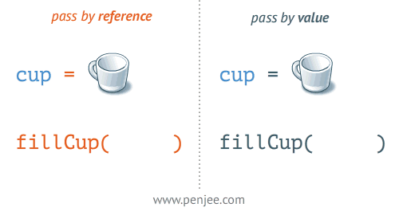
Call by Value vs Call By Reference

Slide 110
Need of namespace
As the same name can’t be given to multiple variables, functions, classes, etc. in the same scope.
So to overcome this situation namespace is introduced.

Slide 111
Namespace std;
A namespace is designed to be used as additional information to differentiate similar functions, classes, variables etc. with the same name available in different libraries. Using namespace, you can define the context in which names are defined. In essence, a namespace defines a scope.
C++ has a standard library that contains common functionality you use in building your applications like containers, algorithms, etc. If names used by these were out in the open, for example, if they defined a queue class globally, you'd never be able to use the same name again without conflicts. So they created a namespace, std to contain this change.
The using namespace statement just means that in the scope it is present, make all the things under the std namespace available without having to prefix std:: before each of them.

Slide 112
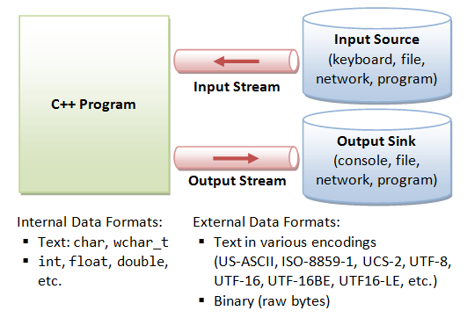

Slide 113
C++ Arrays
Arrays are used to store multiple values in a single variable, instead of declaring separate variables for each value.
To declare an array, define the variable type, specify the name of the array followed by square brackets and specify the number of elements it should store.
Array indexes start with 0: [0] is the first element. [1] is the second element, etc.

Slide 114
Change an Array Element

Slide 115
Arrays and Loops
ou can loop through the array elements with the for loop.

Slide 116
Get the Size of an Array
To get the size of an array, you can use the sizeof() operator
Why did the result show 20 instead of 5, when the array contains 5 elements?
It is because the sizeof() operator returns the size of a type in bytes.
An int type is usually 4 bytes, so from the example , 4 x 5 (4 bytes x 5 elements) = 20 bytes.

Slide 117
To find out how many elements an array has
divide the size of the array by the size of the data type it contains

Slide 118
Multi-Dimensional Arrays
A multi-dimensional array is an array of arrays.
To declare a multi-dimensional array, define the variable type, specify the name of the array followed by square brackets which specify how many elements the main array has, followed by another set of square brackets which indicates how many elements the sub-arrays have.
string letters[2][4];
you can insert values with an array literal
string letters[2][4] = { { "A", "B", "C", "D" }, { "E", "F", "G", "H" } };

Slide 119
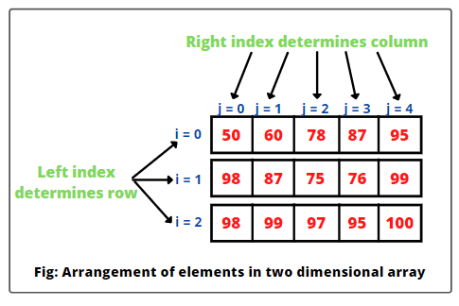
Multi-Dimensional Arrays

Slide 120
Creating Reference
A reference variable is a "reference" to an existing variable, and it is created with the & operator

Slide 121

Memory Address
In the example from the previous slide, the & operator was used to create a reference variable. But it can also be used to get the memory address of a variable; which is the location of where the variable is stored on the computer.
When a variable is created in C++, a memory address is assigned to the variable. And when we assign a value to the variable, it is stored in this memory address.
To access it, use the & operator, and the result will represent where the variable is stored

Slide 122

why is it useful to know the memory address?
References and Pointers (which you will learn about in the next chapter) are important in C++, because they give you the ability to manipulate the data in the computer's memory - which can reduce the code and improve the performance.
These two features are one of the things that make C++ stand out from other programming languages, like Python and Java.

Slide 123
Functions
A function is a block of code which only runs when it is called.
You can pass data, known as parameters, into a function.
Functions are used to perform certain actions, and they are important for reusing code: Define the code once, and use it many times.

Slide 124
Create a Function
C++ provides some pre-defined functions, such as main(), which is used to execute code. But you can also create your own functions to perform certain actions.
To create (often referred to as declare) a function, specify the name of the function, followed by parentheses ()

Slide 125
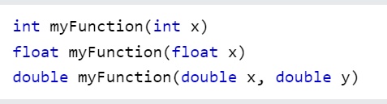
Function Overloading
With function overloading, multiple functions can have the same name with different parameters

Slide 126

Function Overloading

Slide 127

Function Overloading
Instead of defining two functions that should do the same thing, it is better to overload one.
In the example below, we overload the plusFunc function to work for both int and double

Slide 128

Recursion
Technique of making a function call itself. This technique provides a way to break complicated problems down into simple problems which are easier to solve

Slide 129
OOPs

Slide 130
What is OOP?
Object-Oriented Programming.
Procedural programming is about writing procedures or functions that perform operations on the data, while object-oriented programming is about creating objects that contain both data and functions.

Slide 131
DRY Principle
The "Don't Repeat Yourself" (DRY) principle is about reducing the repetition of code.
You should extract out the codes that are common for the application, and place them at a single place and reuse them instead of repeating it.

Slide 132
What are Classes and Objects?
Classes and objects are the two main aspects of object-oriented programming.

Slide 133

C++ Class
A class in C++ is a user defined data type or data structure, which contains data members and member functions. A class is a blueprint of data that defines the characteristics, which can be accessed and used by creating an instance of that class called “object”.
Member functions identify the operations on data members that are the data variables. In other words, member functions are the functions used to manipulate these variables and together these data members and define the properties and behavior of the objects in a class.
When a class is defined, no memory is allocated.
A class is defined using keyword class followed by the class name; and class body, enclosed by a pair of curly braces.

Slide 134
Access Modifiers in C++
Access Modifiers or Access Specifiers in a class are used to set accessibility of the class members.
There are 3 types of access modifiers: public, private and protected. By default access to members of a C++ class is private.

Slide 135

Public
All the class members declared under public will be accessible from anywhere in the program using the direct member access operator(.) with the object of that class.

Slide 136

Private
Private members of a class can be accessed only by the functions inside the class, which facilitates data hiding.
Namely, the private members are not accessible outside the class; they can be accessed only through methods of the class.

Slide 137
Protected
Protected access modifiers are accessible from other members of the same class, are similar to that of private access modifier, but they can be accessed by any subclass(derived class) of that class.

Slide 138
C++ Objects
A class provides a blueprint or a template.
When a class is defined, a class does not occupy any physical space in computer memory until an object of that class type is defined.
If we use the data and access functions defined in the class, we need to create objects.

Slide 139
Create an Object
In C++, an object is created from a class. We have already created the class named MyClass, so now we can use this to create objects.
To create an object of MyClass, specify the class name, followed by the object name.
To access the class attributes (myNum and myString), use the dot syntax (.) on the object

Slide 140

Object

Slide 141

Class Methods
Methods are functions that belongs to the class.
There are two ways to define functions that belongs to a class:
Inside class definition
Outside class definition
You access methods just like you access attributes; by creating an object of the class and using the dot syntax (.)
---->Inside Example

Slide 142

Class Methods
To define a function outside the class definition, you have to declare it inside the class and then define it outside of the class.
This is done by specifying the name of the class, followed the scope resolution :: operator, followed by the name of the function.
Outside Example

Slide 143

Constructors
A constructor in C++ is a special method that is automatically called when an object of a class is created.
To create a constructor, use the same name as the class, followed by parentheses ()
Note: The constructor has the same name as the class, it is always public, and it does not have any return value.

Slide 144

Pillars of OOP's

Slide 145
Encapsulation
The meaning of Encapsulation, is to make sure that "sensitive" data is hidden from users.
To achieve this, you must declare class variables/attributes as private (cannot be accessed from outside the class).
If you want others to read or modify the value of a private member, you can provide public get and set methods.

Slide 146

Encapsulation

Slide 147
Why Encapsulation?
It is considered good practice to declare your class attributes as private (as often as you can).
Encapsulation ensures better control of your data, because you (or others) can change one part of the code without affecting other parts
Increased security of data

Slide 148
Abstraction
Abstraction means displaying only essential information and hiding the details.
Data abstraction refers to providing only essential information about the data to the outside world, hiding the background details or implementation.

Slide 149

Abstraction

Slide 150
Advantages of Data Abstraction
Avoids code duplication and increases reusability.
Helps to increase the security of an application or program as only important details are provided to the user.
It reduces the complexity as well as the redundancy of the code, therefore increasing the readability.

Slide 151
Inheritance
In C++, it is possible to inherit attributes and methods from one class to another. We group the "inheritance concept" into two categories:
derived class (child) - the class that inherits from another class
base class (parent) - the class being inherited from
To inherit from a class, use the : symbol.
In the example below, the Car class (child) inherits the attributes and methods from the Vehicle class (parent)

Slide 152

Inheritance

Slide 153
Why And When To Use "Inheritance"?
It is useful for code reusability: reuse attributes and methods of an existing class when you create a new class.

Slide 154

Types Of Inheritance

Slide 155

Single Inheritance

Slide 156

Multilevel Inheritance
A class can also be derived from one class, which is already derived from another class..

Slide 157

Multilevel Inheritance

Slide 158

Multiple Inheritance
class can also be derived from more than one base class, using a comma-separated list

Slide 159
Polymorphism
Polymorphism means "many forms", and it occurs when we have many classes that are related to each other by inheritance.
Inheritance lets us inherit attributes and methods from another class. Polymorphism uses those methods to perform different tasks. This allows us to perform a single action in different ways.
For example, think of a base class called Animal that has a method called animalSound(). Derived classes of Animals could be Pigs, Cats, Dogs, Birds - And they also have their own implementation of an animal sound (the pig oinks, and the cat meows, etc.).
Remember from the Inheritance slide that we use the : symbol to inherit from a class.

Slide 160
Why And When To Use "Inheritance" and "Polymorphism"?
- It is useful for code reusability: reuse attributes and methods of an existing class when you create a new class.

Slide 161


Slide 162

Files
The fstream library allows us to work with files.
To use the fstream library, include both the standard <iostream> AND the <fstream> header file

Slide 163

Create and Write To a File
To create a file, use either the ofstream or fstream class, and specify the name of the file.
To write to the file, use the insertion operator (<<)

Slide 164

Structures
We often come around situations where we need to store a group of data whether of similar data types or non-similar data types
Structures (also called structs) are a way to group several related variables into one place. Each variable in the structure is known as a member of the structure. It is useful if you have data that is not intended to be modified after creation of struct.
Unlike an array, a structure can contain many different data types
(int, string, bool, etc.).

Slide 165
Structure
In C++, a structure is the same as a class except for a few differences. The most important of them is security
A Structure is not secure and cannot hide its implementation details from the end user while a class is secure and can hide its programming and designing details
The most important of the difference is hiding implementation details.

Slide 166

Class vs Structure

Slide 167

Pointers

Slide 168

Pointer
A pointer however, is a variable that stores the memory address as its value.
A pointer variable points to a data type (like int or string) of the same type, and is created with the * operator.
Usage of pointer
There are many usage of pointers in C++ language.
1) Dynamic memory allocation
In c language, we can dynamically allocate memory using malloc() and calloc() functions where pointer is used.
2) Arrays, Functions and Structures
Pointers in c language are widely used in arrays, functions and structures. It reduces the code and improves the performance.

Slide 169


Pointer
Declaring a pointer
The pointer in C++ language can be declared using ∗ (asterisk symbol).

Slide 170

References
a variable that behaves as an alias for another variable.
can be created by simply using an ampersand (&) operator.
When we create a variable, then it occupies some memory location. We can create a reference of the variable.
Therefore, we can access the original variable by using either name of the variable or reference

Slide 171

References Vs Pointer

Slide 172
Algorithms

Slide 173

Sorting

Slide 174
Types Of Sorting
Bubble Sort
Selection Sort
Insertion Sort
Quick Sort
Merge Sort

Slide 175

Bubble Sort
Bubble sort is one of the most straightforward sorting algorithms.
In this sorting technique,
we begin by comparing the first two elements of the array and checking if the first element is greater than the second element; if it is, we will swap those elements and move forward to the next element.

Slide 176

Visualise Bubble Sort

Slide 177

Selection Sort
The smallest element is fetched by comparing itself with the rest of the elements and sorted at the array's first position.
The complete array is divided into two halves, the sorted subarray on the left and the unsorted subarray on the right. Once the first element is sorted, the search for the second minimum element begins from the rest of the array and is positioned at second place.

Slide 178

Visualize Selection Sort

Slide 179

Insertion Sort
Works similar to the sorting of playing cards in hands. It is assumed that the first card is already sorted in the card game, and then we select an unsorted card.
The idea behind the insertion sort is that first take one element, iterate it through the sorted array.
Insertion sort is less efficient than the other sorting algorithms like heap sort, quick sort, merge sort, etc.

Slide 180


Visualize Insertion Sort

Slide 181

Quick Sort
follows the Divide and conquer approach
Quick sort is a highly efficient sorting algorithm and is based on partitioning of array of data into smaller arrays.
A large array is partitioned into two arrays one of which holds values smaller than the specified value.
based on which the partition is made and another array holds values greater than the pivot value

Slide 182


Divide and conquer
Divide: In Divide, first pick a pivot element. After that, partition or rearrange the array into two sub-arrays such that each element in the left sub-array is less than or equal to the pivot element and each element in the right sub-array is larger than the pivot element.
Conquer: Recursively, sort two subarrays with Quicksort.
Combine: Combine the already sorted array.

Slide 183

Merge Sort
follows the Divide and Conquer approach
Merge sort is similar to the quick sort algorithm
It divides the given list into two equal halves, calls itself for the two halves and then merges the two sorted halves. We have to define the merge() function to perform the merging.
The sub-lists are divided again and again into halves until the list cannot be divided further

Slide 184


Split & Merge

Slide 185

Searching
Searching is the process of finding some particular element in the list. If the element is present in the list, then the process is called successful, and the process returns the location of that element; otherwise, the search is called unsuccessful.
Searching Algorithms are designed to check for an element or retrieve an element from any data structure where it is stored. Based on the type of search operation, these algorithms are generally classified into two categories:
Sequential Search.
Interval Search.

Slide 186

Sequential Search
the list or array is traversed sequentially and every element is checked. For example: Linear Search
Linear Search is defined as a sequential search algorithm that starts at one end and goes through each element of a list until the desired element is found, otherwise the search continues till the end of the data set. It is the easiest searching algorithm

Slide 187

Binary Search
Binary search is the search technique that works efficiently on sorted lists.
Hence, to search an element into some list using the binary search technique, we must ensure that the list is sorted.
Binary search follows the divide and conquer approach in which the list is divided into two halves, and the item is compared with the middle element of the list. If the match is found then, the location of the middle element is returned. Otherwise, we search into either of the halves depending upon the result produced through the match.

Slide 188

Binary Search vs Sequential Search

Slide 189
Structures
We often come around situations where we need to store a group of data whether of similar data types or non-similar data types
Structures (also called structs) are a way to group several related variables into one place. Each variable in the structure is known as a member of the structure. It is useful if you have data that is not intended to be modified after creation of struct.
Unlike an array, a structure can contain many different data types
(int, string, bool, etc.).

Slide 190
Structure
In C++, a structure is the same as a class except for a few differences. The most important of them is security
A Structure is not secure and cannot hide its implementation details from the end user while a class is secure and can hide its programming and designing details
The most important of the difference is hiding implementation details.

Slide 191
Class vs Structure

Slide 192
Pointers

Slide 193
Pointer
A pointer however, is a variable that stores the memory address as its value.
A pointer variable points to a data type (like int or string) of the same type, and is created with the * operator.
Usage of pointer
There are many usage of pointers in C++ language.
1) Dynamic memory allocation
In c language, we can dynamically allocate memory using malloc() and calloc() functions where pointer is used.
2) Arrays, Functions and Structures
Pointers in c language are widely used in arrays, functions and structures. It reduces the code and improves the performance.

Slide 194
Pointer
Declaring a pointer
The pointer in C++ language can be declared using ∗ (asterisk symbol).

Slide 195
References
a variable that behaves as an alias for another variable.
can be created by simply using an ampersand (&) operator.
When we create a variable, then it occupies some memory location. We can create a reference of the variable.
Therefore, we can access the original variable by using either name of the variable or reference

Slide 196
References Vs Pointer

Slide 197
Control Statements
if statement is used to test the condition. There are various types of if statements in C++.
if statement
if-else statement
nested if statement
if-else-if ladder

Slide 198
If-else Loop
if-else statement also tests the condition.
It executes if block if condition is true otherwise else block is executed.

Slide 199
Goto Statement
Also known as jump statement. It is used to transfer control to the other part of the program. It unconditionally jumps to the specified label.
It can be used to transfer control from deeply nested loop or switch case label.

Slide 200
Do-While Loop
Used to iterate a part of the program several times.
If the number of iteration is not fixed and you must have to execute the loop at least once

Slide 201
While Loop
used to iterate a part of the program several times. If the number of iteration is not fixed.
it is recommended to use while loop than for loop.

Slide 202
For loop
used to iterate a part of the program several times. If the number of iteration is fixed, it is recommended to use for loop than while or do-while loops.

Slide 203
Switch case
Used for executing one condition from multiple conditions.
It is similar to an if-else-if ladder. Switch statement consists of conditional based cases and a default case. In a switch statement, the “case value” can be of “char” and “int” type

Slide 204
Continue Statement
Used to continue loop.
It continues the current flow of the program and skips the remaining code at specified condition. In case of inner loop, it continues only inner loop.

